Slide 1
Prototypes

Slide 2
Authors and Presenters
Presented by:
Leo Chen
Danial Nor Azman
17/11/2022

Slide 3
What is the Prototype Design Pattern?
Allow the cloning of an existing instance of an object without the need for creating new ones
It is when you want to duplicate the same object to be modified later
17/11/2022

Slide 4
Purpose
Its like copy constructor but the different is that you use copy constructor when you know exactly what you want but prototype design pattern allows you to clone it when there are multiple possible implementations.
Prototype mainly used during run time
17/11/2022

Slide 5
Pros
Advantages of using pattern
Clone objects without being tied to their concrete class
Can get rid of repeated init code in favour of cloning pre-built prototypes
Produce complex objects more conveniently
Get an alternative to inheritance when dealing with config presets for complex objects
17/11/2022

Slide 6
Cons
Issues associated with Pattern
Cloning complex objects that have circular references might be very tricky
17/11/2022

Slide 7
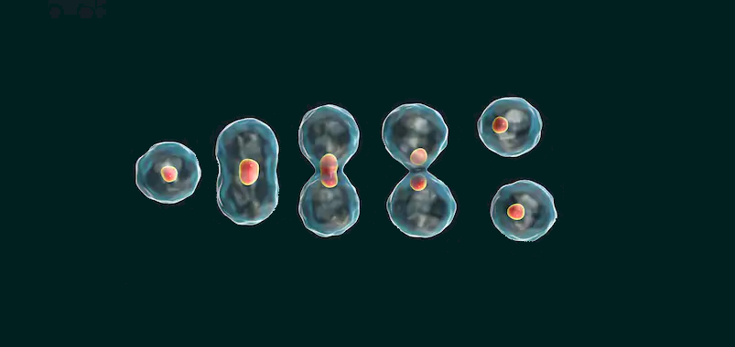
Example Usage
17/11/2022

Slide 8
Sample Code
Sample code to be shown on Visual Studio
17/11/2022

